Slide 1
Data Communications

Slide 2

Layered Architecture
ISO : international organization for standardization
OSI : Open System interconnection model
.

Slide 3
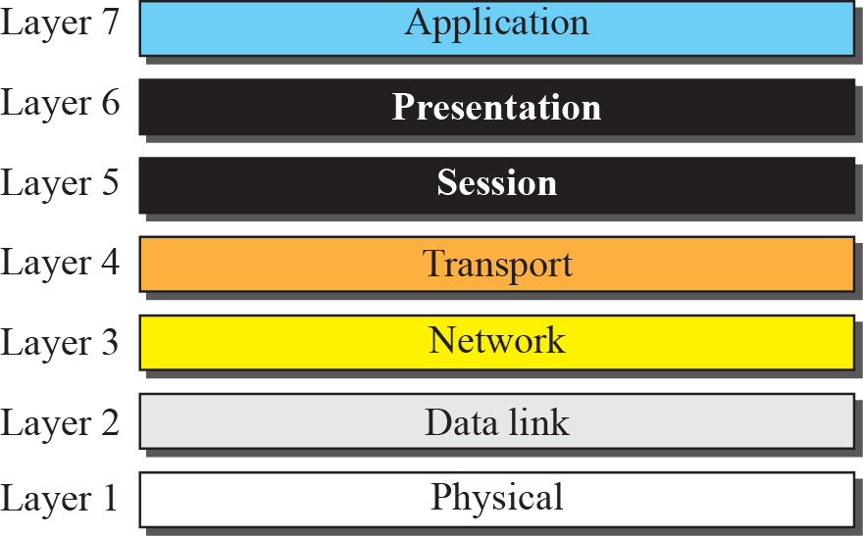
Layered Architecture
.

Slide 4
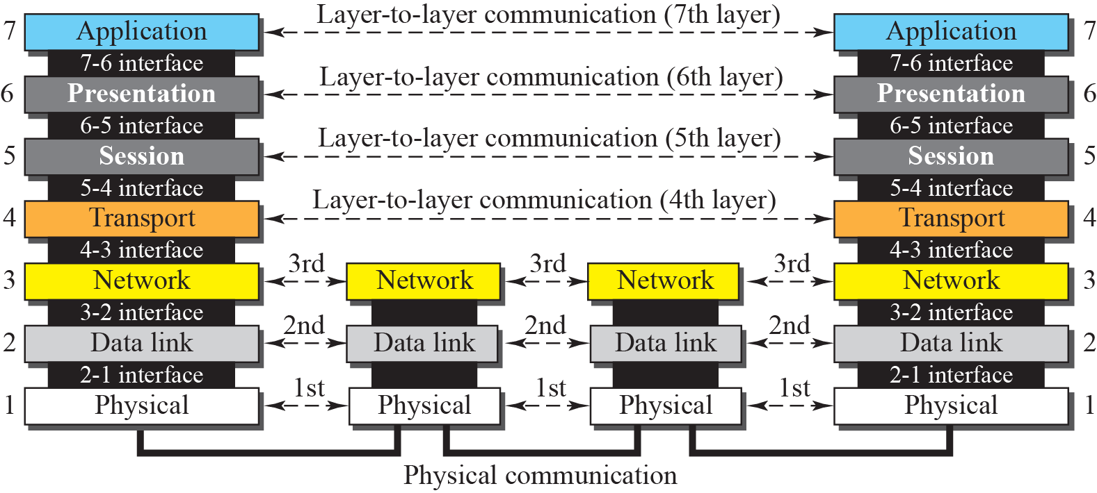
.

Slide 5
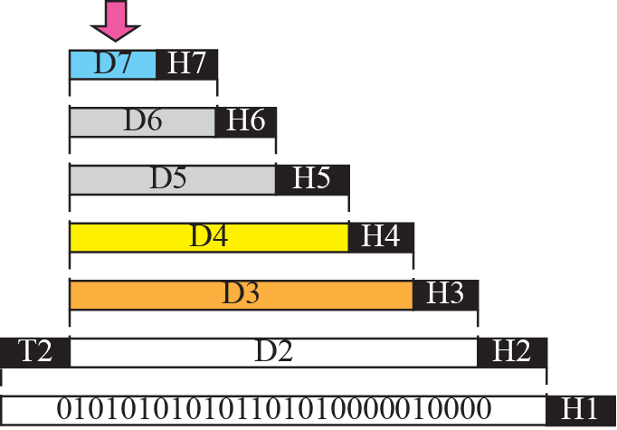


An Exchange using the OSI model
.

Slide 6
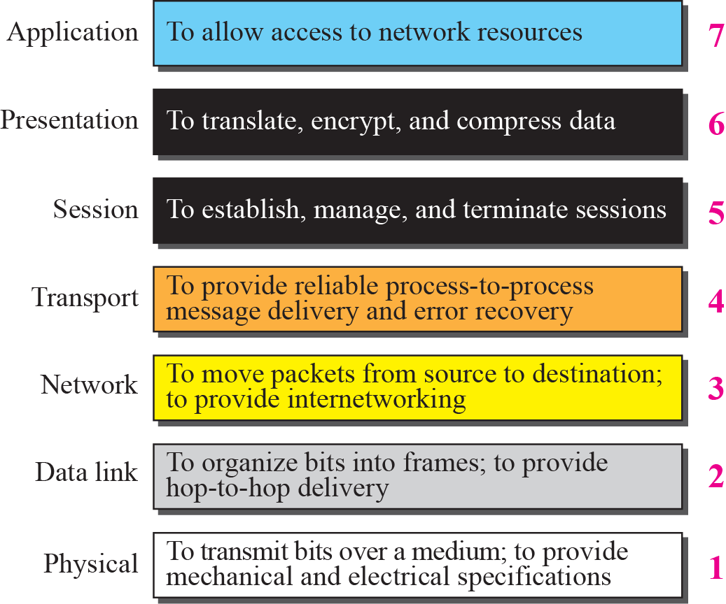
.

Slide 7
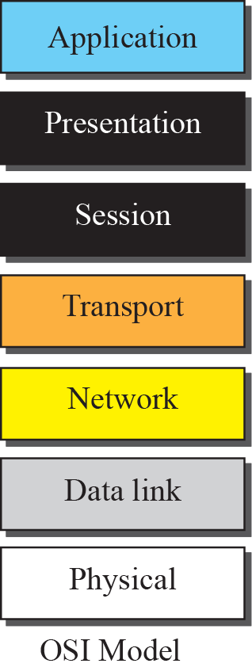
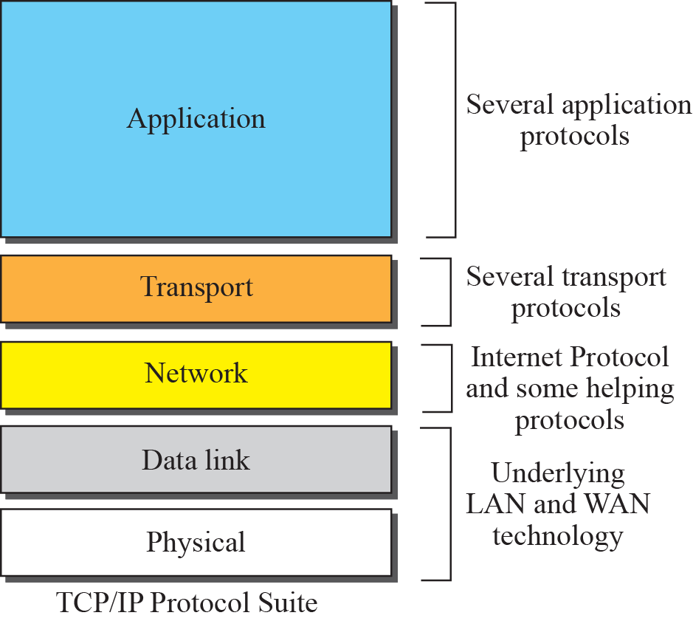
TCP/IP Protocol Suite
.

Slide 8
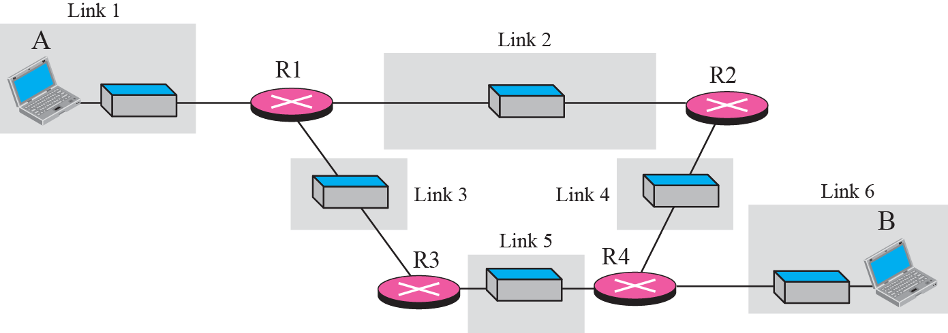
.

Slide 9
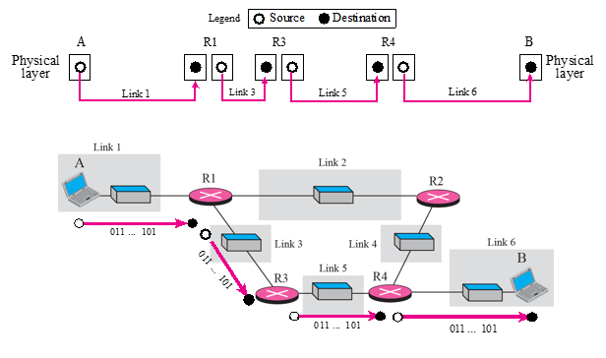
.

Slide 10
The unit of communication at the physical layer is a bit.
.

Slide 11
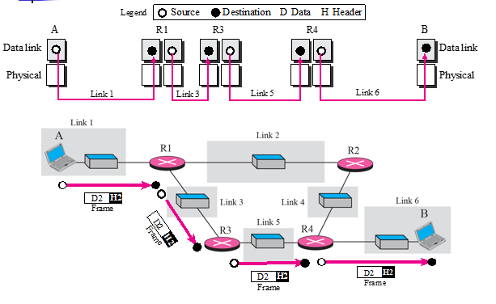
.

Slide 12
The unit of communication at the data link layer is a frame.
.

Slide 13
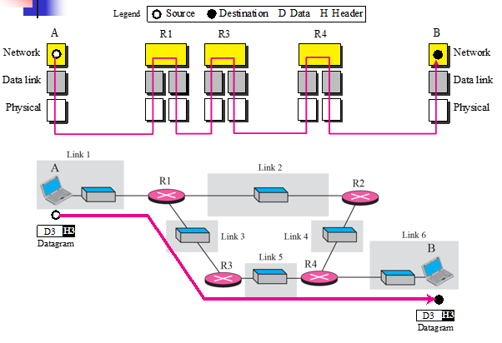
.

Slide 14
The unit of communication at the network layer is a datagram.
.

Slide 15
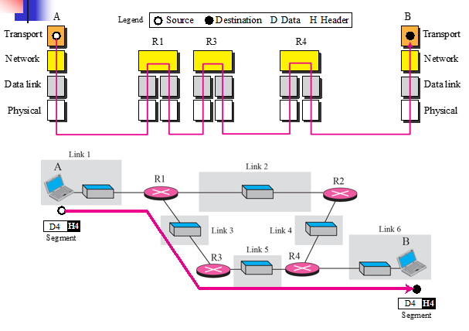
.

Slide 16
The unit of communication at the transport layer is a segment, user datagram, or a packet, depending on the specific protocol used in this layer.
.

Slide 17
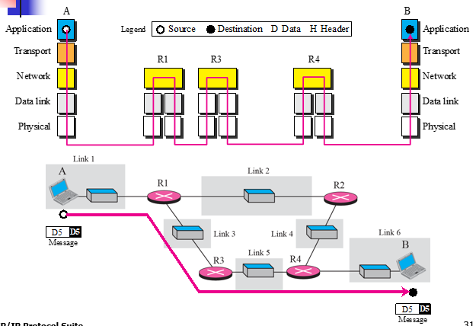
.

Slide 18
The unit of communication at the application layer is a message.
.

Slide 19
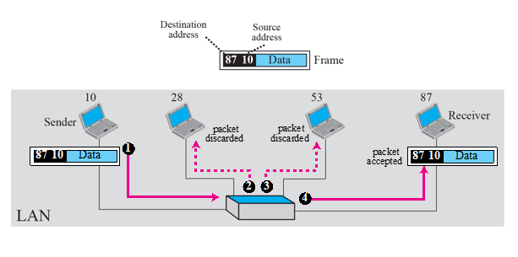
.

Slide 20
local area networks use a 48-bit (6-byte) physical address written as 12 hexadecimal digits;
every byte (2 hexadecimal digits) is separated by a colon, as shown below:
07:01:02:01:2C:4B
A 6-byte (12 hexadecimal digits) physical address
.

Slide 21
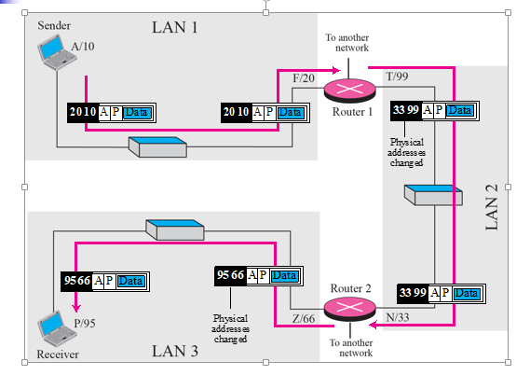
.

Slide 22
The physical addresses will change from hop to hop, but the logical addresses remain the same.
.

Slide 23
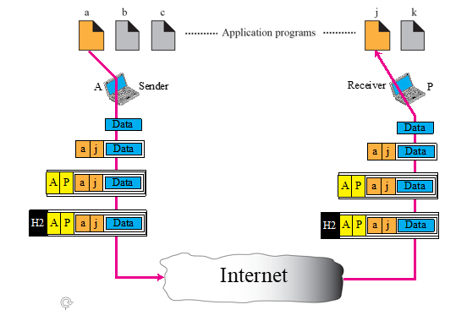
.

Slide 24
The physical addresses change from hop to hop, but the logical and port addresses usually remain the same.
.

Slide 25
753
A 16-bit port address represented as one single number
.

Slide 26
END
.

